Slide 1

Northeastern University - Seattle
CS6650 Building Scalable Distributed Systems
Vishal Rajpal

Slide 2
Week 11 – Strong Consistency
Topics we will cover today:
Two Phase Commit
Consensus
RAFT

Slide 3
Two Phase Commit
Classic distributed transaction consensus algorithm
Widely implemented:
major relational databases
Messaging systems
Java Transaction API and Java Transaction Service in JEE
XA protocol
Open standard for interoperability
Supports transactions across heterogeneous databases

Slide 4
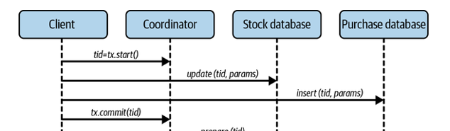
Two Phase Commit
Coordinator role:
Allocates a unique transaction id (tid)
Tid identifies persistent transaction context
Context records transaction participants
State of communications with each participant
Participants
Acquire locks on update objects
Updates not visible until transaction commits

Slide 5
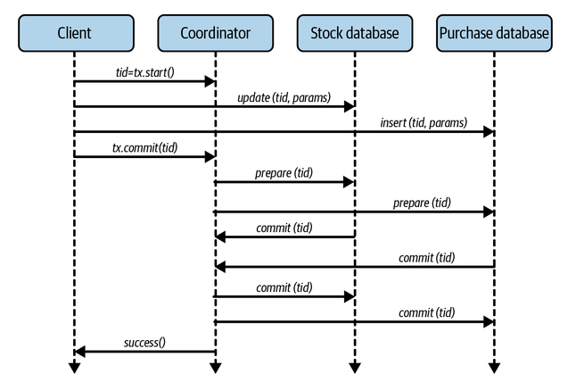
Two Phase Commit

Slide 6
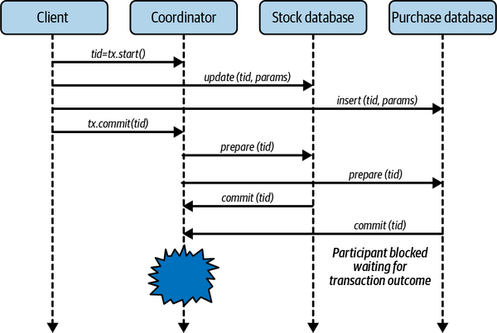
Two Phase Commit
Failure Modes
Participant
Fails before prepare phase
Coordinator rolls back transaction
Fails after replying to prepare
May commit or abort depending on participant responses
On recovery, ask coordinator for transaction outcome
Participant failure doesn’t threaten consistency
Coordinator
No simple solution
Participants blocked until coordinator recovers
For how long?
Must hold locks on updated objects
2PC not tolerant to coordinator failure
SPoF
Systems can’t make progress
Notes:
2PC has two main failure modes. These are participant failure and coordinator failure. As usual, failures can be caused by systems crashing, or being partitioned from the rest of the application. From the perspective of 2PC, the crashes and partitions are indistinguishable:
Participant failure
When a participant crashes before the prepare phase completes, the transaction is aborted by the coordinator. This is a straightforward failure scenario.
It’s also possible for a participant to reply to the prepare message and then fail. In either case, when the participant restarts, it needs to communicate with the coordinator to discover transaction outcomes. The coordinator can use its transaction log to look up the outcomes and inform the recovered participant accordingly. The participant then completes the transaction locally.
Essentially then, participant failure doesn’t threaten consistency, as the correct transaction outcome is reached.
Coordinator Failure
Should the coordinator fail after sending the prepare message, participants have a dilemma. Participants that have voted to commit must block until the coordinator informs them of the transaction outcome.
If the coordinator crashes before or during sending out the commit messages, participants cannot proceed, as the coordinator has failed and will not send the transaction outcome until it recovers.

Slide 7
Two Phase Commit
Solution to Coordinator Failure
3PC
replicate coordinator state
Treat as leader-follower system
Replica can be promoted to coordinator in case of failure
Many solutions
Paxos
Raft
Notes:
3PC – Has additional step before

Slide 8
Consensus
Example: online auction
Multiple last second bids
Bids (updates) sent to different replicas
Need Consensus (agreement) on final value
Consensus Properties
Safety: All replicas agree on same winning bid
Liveness: a single winning bid is eventually agreed upon
Correctness: the winning bid is one of the bids submitted
Notes:
As an example of the need for consensus, imagine what could happen at the end of an online auction when multiple last second bids are submitted. This is equivalent to multiple clients sending update requests that can be handled by different replicas of the same auction data object. In an eventually consistent system, this could lead to replicas with different bid values and potentially the loss of the highest bid.
A consensus algorithm makes sure such problems cannot occur. More specifically:
All replicas must agree on the same winning bid. Safety properties ensure nothing bad happens. In this case, two winning bids would be bad.
A single winning bid is eventually selected. This is a liveness property. Liveness ensures something good happens and the system makes progress. In this case consensus is eventually reached on a single winning bid. Consensus algorithms that guarantee liveness are known as fault-tolerant consensus algorithms.
The winning bid is one of the bids that was submitted. This ensures the algorithm can’t simply be hardcoded to agree on a predetermined value.

Slide 9
Fault Tolerant Consensus Algorithms
Known variously as:
Atomic broadcast
Total order broadcast
Replicated state machines
Updates/states delivers to multiple nodes:
Exactly once
In same order
Achieve consensus when:
Leader fails
Detect leader failure
Select new leader from followers
Recovery protocol to ensure all replicas consistent with new leader
Followers fail
Algorithms makes progress with quorum of follower

Slide 10
RAFT
Leader accepts all updates
Defines order of updates
Sends updates to replicas in defined order
All replicas maintain identical committed state
Updates maintained in a log at each replica
Notes:
Raft is a leader-based algorithm. The leader accepts all updates and defines an order for their execution. It then takes responsibility for sending these updates to all replicas in the defined order, such that all replicas maintain identical committed states. The updates are maintained as a log, and Raft essentially replicates this log to all members of the system.

Slide 11
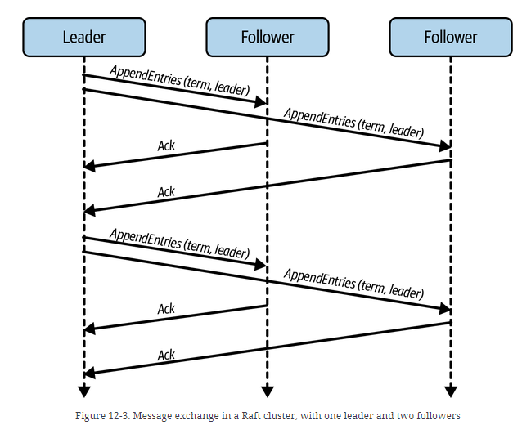
RAFT
All client updates sent to leader replica
Leader appends updates to local uncommitted log
Leader sends updates to followers using AppendEntries()
Value, Term, log position
Followers persist entries to local uncommitted log and acknowledge to leader
When majority of replicas acknowledge
Leader moves updates to committed log
Communicates decision to all replicas
Notes:
A Raft cluster has an odd number of nodes, for example, three or five. This enables consensus to proceed based on quorums. At any instant, each node is either a leader, a follower, or a candidate for leader if a leader failure has been detected. The leader sends periodic heartbeat messages to followers to signal that it is still alive. The message flow in a basic Raft cluster architecture is shown in Figure 12-3. The time period for leader heartbeats is typically around 300–500 milliseconds.
Each leader is associated with a monotonically increasing value known as a term. The term is a logical clock, and each valid term value is associated with a single leader. The current term value is persisted locally by every node in the cluster, and is essential for leader election. Each heartbeat message contains the current term value and leader identity and is delivered using an AppendEntries() message. AppendEntries() is also utilized to deliver new entries to commit on the log. During idle periods when the leader has no new requests from clients, an empty AppendEntries() simply suffices as the heartbeat.

Slide 12
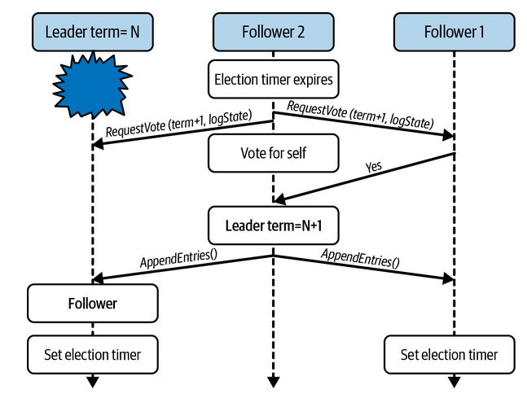
RAFT
Followers maintain an election timer
No heartbeat in timeout period, follower start an election
Changes state to candidate
Increments election term (logical clock)
Sends RequestVote() to all nodes
Votes for itself
If majority of votes received, follower becomes leader
If not, remains candidate and resets election timer
Notes:
The leader in Raft sends periodic heartbeat messages to followers.
Each follower maintains an election timer, which it starts after receiving a heartbeat message.
If the timer expires before another heartbeat is received, the follower starts an election.
Election timers are randomized to minimize the likelihood that multiple followers time out simultaneously and call an election.
If a follower’s election timeout expires, it changes its state to candidate, increments the election term value, and sends a RequestVote message to all nodes. It also votes for itself.
The RequestVote message contains the candidate’s identifier, the new term value, and information about the state of the committed entries in the candidate’s log.
The candidate then waits until it receives replies. If it receives a majority of positive votes, it will transition to leader, and start sending out heartbeats to inform the other nodes in the cluster about its newly acquired status.
If a majority of votes are not received, it remains a candidate and resets its election timer.

Slide 13
RAFT
Safety
Candidate cannot receive vote from replica with more upto date committed log
Candidate backs down
New election started
Ensures new leader has all committed entries from previous term
Two followers start election simultaneously?
Increment terms
Send RequestVote()
Mitigated by rule:
“any node can only vote once within a single term”
One candidate can win
Neither wins – reset election timers
Notes:
These conditions on Raft’s leader election ensure that any elected leader has all the committed entries from previous terms in its log.
If a candidate does not have all committed entries in its log, it cannot receive a positive vote from more up-to-date followers.
The candidate will then back down, another election will be started, and eventually a candidate with the most up-to-date log entries will win.
It’s also possible for the election timers of two or more followers to expire simultaneously. When this happens, each follower will transition to a candidate, increment the term, and send RequestVote messages. Raft enforces a rule whereby any node can only vote once within a single term. Hence, when multiple candidates start an election:
One may receive a majority of votes and win an election.
None may receive a majority. In this case, candidates reset their election timers and another election will be initiated. Eventually a leader will be elected.

Slide 14
Summary
Two Phase Commit
Consensus
RAFT

Slide 15
Questions?

